Slide 1
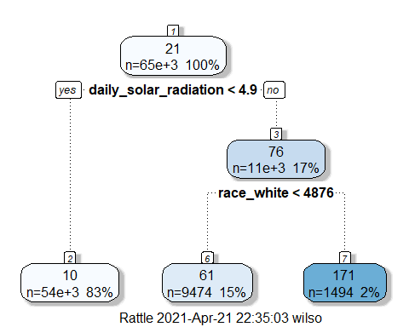
Solar Adaptation & Barriers: Who is Switching to Solar?
Emily Wilson
St. John Fisher College, Rochester NY
ABSTRACT
OBJECTIVES
REGRESSION OUTPUT
LIMITATIONS
In the interest of growing renewable energy implementation, this project broadly examines characteristics and demographics of those who adapted solar panels to identify solar deployment patterns. The information gained from this research can be utilized to understand the current accessibility of residential solar power. The data for this study comes from Stanford’s DeepSolar Project, a learning framework that analyzes satellite imagery to identify the GPS locations of solar panels across United States counties. Given that the data is collected from satellite imagery as opposed to administered voluntary surveys, it provides a better representation of homeowners with solar and allows for more accurate conclusions to be drawn. In order to execute a simplified model of the numerous predictor variables, the structure of the data is observed through the principal component analysis technique in RStudio to determine which variables to extract for a linear regression and classification tree model. The models support that daily solar radiation, race and household income, all have a significant and positive impact on solar deployment patterns. The final product of both models emphasizes that solar tends to go in places that are predominately white, wealthy, and with better radiation and climate conditions.
Examine demographics and identify who is more likely to adopt solar
Identify barriers and to directly address public perceptions of solar.
 | Model 1
(Intercept) | -189.93 ***
 | (2.93)
average_household_size | 2.69 ***
 | (0.45)
median_household_income | 0.00 ***
 | (0.00)
land_area | -0.01 ***
 | (0.00)
race_white | 0.00 ***
 | (0.00)
daily_solar_radiation | 38.91 ***
 | (0.54)
N | 65089
AdjR2 | 0.24
Standard errors are heteroskedasticity robust. *** p < 0.01; ** p < 0.05; * p < 0.1.
The initial approach of this study was hierarchical clustering due to its ability to group data points based on similarities. However, the size and magnitude of the dataset added additional barriers. Principal component analysis came to be a simpler and time-saving alternative.
Additional modeling considered for the study and potential next steps:
K-Nearest Neighbors modeling
Running ANOVAS with the classification tree outputs
Many acknowledge the importance of clean energy but dismiss the persistent gaps between renewable potential and actual adoption of the alternative. Previous literature emphasizes how lack of information can play a role, but information alone is not enough to generate motivation. Solar currently perceives itself as unaffordable due to startup costs, however financial returns and lower utility expenses provide incentives for switching. Technological advancements in recent years have also made the option more cost effective. As time goes on and technology improves, solar power will hopefully become more affordable, allowing more people to access it.
METHODS
Principal component analysis is an autonomous method that assists in reducing the depth of the dataset, allowing for much of the variability to be explained with less variables. This approach is fitting for this study since the original dataset contained 72,537 observations and 169 variables. The following steps were implemented to build the models:
Evaluate dataset through PCA in RStudio, standardizing and centering the data too.
Select the PCA and variables
Run selected variables through predictive models: linear regression and classification tree
Interpret output, draw conclusions
DISCUSSION
RESULTS
PCA 6 came in with an overall cumulative proportion of .65 and variation of .04 and became the PCA of interest out of 34. A threshold of .2 was placed on the eigenvalues for selection, giving five variables to work with instead of 169.
The variables listed above were extracted and used in a regression and revealed an R-squared of .24 and daily solar radiation having the most impactful effect.
The classification tree aligns with the regression output in that radiation comes in as the greatest influence for solar, followed by race.
CLASSIFICATION TREE
REFERENCES
Varun Rai, Ariane L. Beck, Play and learn: Serious games in breaking informational barriers in residential solar energy adoption in the United States, Energy Research & Social Science, Volume 27, 2017, Pages 70-77.
CONTACT
Email: emw02268@sjfc.edu

